Slide 1
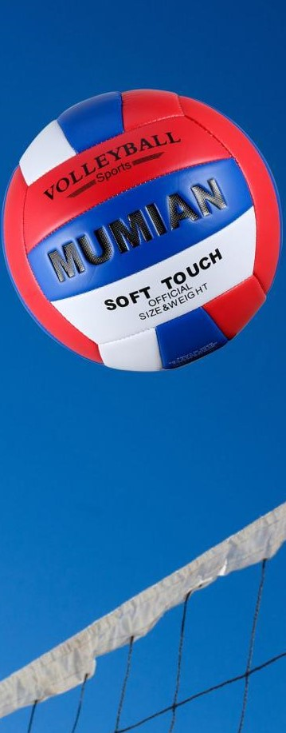
Westside High School
Sept. 12-16 Week At a Glance (WAG)

Slide 2
Coach Thomas
Rec. Games: Sept 12-16

Slide 3
Monday - Agenda
Sept 12
Standard:
PERG.1 The physically educated student demonstrates competency in a variety of motor skills and movement patterns.
a. Demonstrates competence while performing skills in a variety of recreational game settings and activities
b. Performs skills at a level of competence, which contributes to health-related fitness.
c. Demonstrates proper warm-up and cool-down protocol associated with different life time
sport physical activities.
PERG.3 The physically educated student demonstrates knowledge and skills to help achieve
and maintain a health-enhancing level of physical activity and fitness.
a. Maintains or improves fitness level by using the results of the Georgia Fitness Assessment
to guide changes in a personal program of physical activity.
b. Uses technologies to assess, enhance, and maintain health-related and skill-related fitness.
c. Analyzes the relationship between physical activity and longevity.
Personal and Social Behavior, Rules, Safety, and Etiquette
Learning Target
I can explain the basic rules of wiffle ball and kick ball
I can use the rules and techniques to play a game of wiffle ball and kick ball
Opening ( 10-15 mins)
10 minute Walk & Attendance
Work-session ( 20 - 25 mins)
Locker rooms (5 minutes)
Coach will explain the rules of wiffle ball and kick ball
Coach will demonstrate batting techniques for wiffle ball
Students will split into teams and play a game or two of each
Criteria for Success
Students can participate in a game of wiffle ball and kick ball by following the rules and using proper techniques
Closing ( 05 – 10 mins)
-locker room unlocked for 5 minutes
-students use remaining time to cool down & rehydrate if necessary

Slide 4
Tuesday - Agenda
Sept 13 Standard:
PERG.1 The physically educated student demonstrates competency in a variety of motor skills and movement patterns.
a. Demonstrates competence while performing skills in a variety of recreational game settings and activities
b. Performs skills at a level of competence, which contributes to health-related fitness.
c. Demonstrates proper warm-up and cool-down protocol associated with different life time
sport physical activities.
PERG.3 The physically educated student demonstrates knowledge and skills to help achieve
and maintain a health-enhancing level of physical activity and fitness.
a. Maintains or improves fitness level by using the results of the Georgia Fitness Assessment
to guide changes in a personal program of physical activity.
b. Uses technologies to assess, enhance, and maintain health-related and skill-related fitness.
c. Analyzes the relationship between physical activity and longevity.
Personal and Social Behavior, Rules, Safety, and Etiquette
Learning Target
Same as previous day
Opening ( 10-15 mins)
10 minute Walk & Attendance
Work-session ( 20 - 25 mins)
Criteria for Success
Review of rules for wiffle ball & kick ball with compare and contrast
Students participate in games
Same as previous day
Closing ( 05 – 10 mins)
locker room unlocked for 5 minutes
-students use remaining time to cool down & rehydrate if necessary

Slide 5
Wednesday - Agenda
Sept 14 Standard:
PERG.1 The physically educated student demonstrates competency in a variety of motor skills and movement patterns.
a. Demonstrates competence while performing skills in a variety of recreational game settings and activities
b. Performs skills at a level of competence, which contributes to health-related fitness.
c. Demonstrates proper warm-up and cool-down protocol associated with different life time
sport physical activities.
PERG.3 The physically educated student demonstrates knowledge and skills to help achieve
and maintain a health-enhancing level of physical activity and fitness.
a. Maintains or improves fitness level by using the results of the Georgia Fitness Assessment
to guide changes in a personal program of physical activity.
b. Uses technologies to assess, enhance, and maintain health-related and skill-related fitness.
c. Analyzes the relationship between physical activity and longevity.
Personal and Social Behavior, Rules, Safety, and Etiquette
Learning Target
Same as previous day
Opening ( 10-15 mins)
10 minute Walk & Attendance
Work-session ( 20 - 25 mins)
Same as previous day
Criteria for Success
Same as previous day.
Closing ( 05 – 10 mins)
-locker room unlocked for 5 minutes
-students use remaining time to cool down & rehydrate if necessary

Slide 6
Thursday - Agenda
Sept 15 Standard:
PERG.1 The physically educated student demonstrates competency in a variety of motor skills and movement patterns.
a. Demonstrates competence while performing skills in a variety of recreational game settings and activities
b. Performs skills at a level of competence, which contributes to health-related fitness.
c. Demonstrates proper warm-up and cool-down protocol associated with different life time
sport physical activities.
PERG.3 The physically educated student demonstrates knowledge and skills to help achieve
and maintain a health-enhancing level of physical activity and fitness.
a. Maintains or improves fitness level by using the results of the Georgia Fitness Assessment
to guide changes in a personal program of physical activity.
b. Uses technologies to assess, enhance, and maintain health-related and skill-related fitness.
c. Analyzes the relationship between physical activity and longevity.
Personal and Social Behavior, Rules, Safety, and Etiquette
Learning Target
I can demonstrate my mastery of this week’s learning targets
Opening ( 10-15 mins)
5 minute Walk & Attendance
Work-session ( 20 - 25 mins)
Teacher explain assessment procedure
-Students will be called to perform assessments based on teacher expectations of skills learned this week
Criteria for Success
Same as previous day
Closing ( 05 – 10 mins)
-locker room unlocked for 5 minutes
-students use remaining time to cool down & rehydrate if necessary

Slide 7
Friday - Agenda
Sept 16 Standard:
PERG.1 The physically educated student demonstrates competency in a variety of motor skills and movement patterns.
a. Demonstrates competence while performing skills in a variety of recreational game settings and activities
b. Performs skills at a level of competence, which contributes to health-related fitness.
c. Demonstrates proper warm-up and cool-down protocol associated with different life time
sport physical activities.
PERG.3 The physically educated student demonstrates knowledge and skills to help achieve
and maintain a health-enhancing level of physical activity and fitness.
a. Maintains or improves fitness level by using the results of the Georgia Fitness Assessment
to guide changes in a personal program of physical activity.
b. Uses technologies to assess, enhance, and maintain health-related and skill-related fitness.
c. Analyzes the relationship between physical activity and longevity.
Personal and Social Behavior, Rules, Safety, and Etiquette
Learning Target
Freestyle Friday
Opening ( 10-15 mins)
Attendance
Work-session ( 20 - 25 mins)
Students are able to engage in various activities/sports typically those that they are most interested
Teacher will conference will students and possibly make parent phone calls/contact as needed
Criteria for Success
I can demonstrate my understanding of the rules, procedures, and expectations by following them during class time and asking questions to teacher if necessary.
Closing ( 05 – 10 mins)
N/A

Slide 8
Resources
https://www.youtube.com/watch?v=RIc5Ld_oSRM
https://www.nike.com/nrc-app
https://www.youtube.com/watch?v=4vnD991J22g
https://www.youtube.com/watch?v=vvukFoXudy4

